Slide 1
Stock Market Price Prediction
STAT3011
1155177100 KO Ming
1155173901 WEI Han Jie
1155177174 LAU Trenton
1155156341 ZHANG Xinyi
1155173795 CAO Zheming
1155157925 YEUNG Ching Hin

Slide 2
Table of contents
Replication
Window Expansion
NLP
LSTM
01
02
Case Replication:
Stock Market Prediction.
Methodology:
Adjust Sample Size.
03
04
Sentiment Analysis:
Is R better than Python?
A Better Approach:
Long Short-Term Memory.

Slide 3
Replication
01

Slide 4

1.1 Prediction Model
Machine Learning Algorithm
Random Forest Regressor.
Logistic Regression.
Multilayer Perceptron (MLP).
Unexpected Difficulties
Some of the code is outdated since some function is updated, therefore codes were adjusted during case replication.

Slide 5
1.1 Prediction Model
Objective
Predict adj close price
Why adj close price over close price
these prices give us a better idea about what the last price of the DJIA index is
Act like an upper bound for the close price

Slide 6
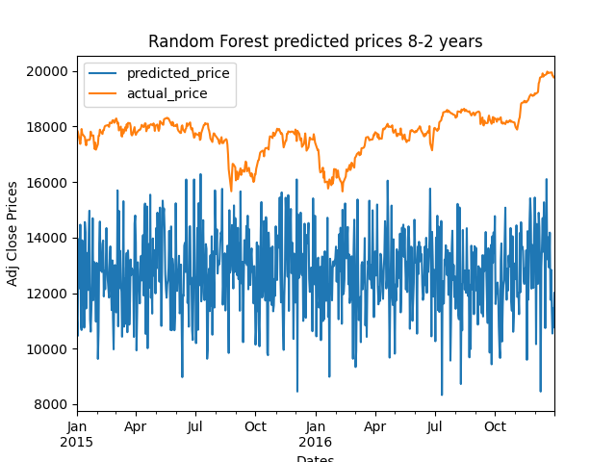
1.2 Random Forest Regressor
Combines multiple decision trees to make predictions.
Each tree is built on a randomly sampled subset of the training data.
The final prediction -> averaging the predictions.
8 year of training data, 2 year of testing data.

Slide 7
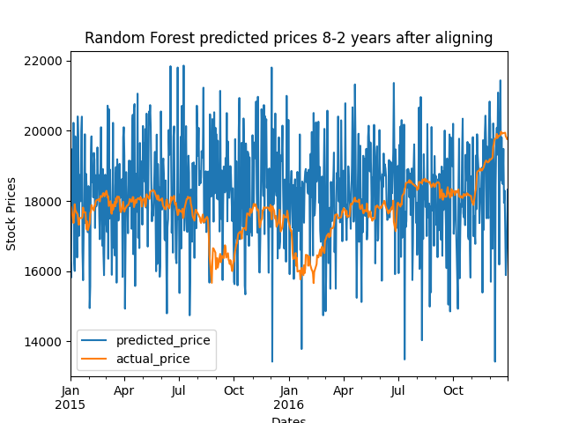
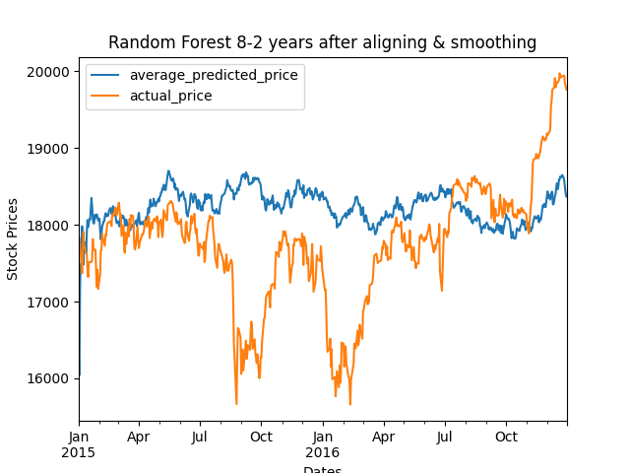
1.3 Alignment and Smoothing
Alignment
Smoothing
Increasing the prices using a constant value. Actual price in testing the dataset will be aligned.
An exponentially weighted moving average. Smoothing based on the weighted average concept.

Slide 8
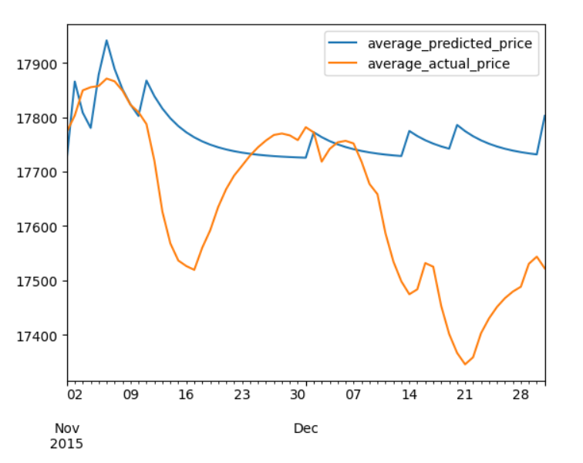
1.4 Logistic Regression
Used for binary classification tasks.
With the binary outcome -> rise or fall.
A year-wise graph of Nov 2015 for logistic Regression, we see a slight improvement using this model.

Slide 9
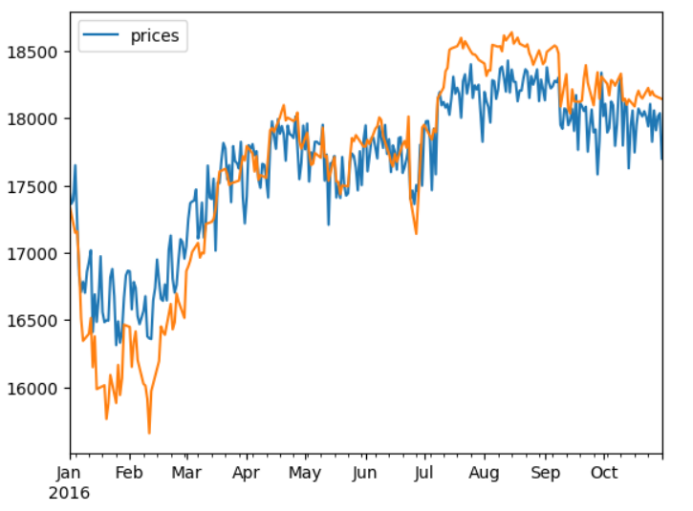
1.5 Multilayer Perceptron (MLP)
A neural network-based algorithm.
Capture complex relationships and model non-linear patterns in data.

Slide 10
1.6 Other ML Algorithm
Logistic Regression
Multilayer perceptron
Better than Random Forest Regressor.
Datasets are not normalized.
Only slight improvement.
Can handle normalization and overfitting.
It is a neural network-based algorithm.
Best approach among the other two .
Although MLP perform better, extreme fluctuation still can’t be predicted.
Minor and major improvement can be done.

Slide 11
Window Expansion
02

Slide 12
2.1 Original Performance
Random Forest
Logistic Regression
Multilayer Perception
MSE = 27802863
MSE = 1087061
MSE = 1050759

Slide 13
2.2 Expand the Training Dataset
Extending the historical data window to include more past observations
More Information
Increased Complexity
Robustness

Slide 14
2.2 Expand the training dataset
Before
After
8 years
From '07-01-01’ to '14-12-31'
10 months each year
From Jan to the end of Oct
9 years
From '07-01-01’ to '15-12-31'
11 months each year
From Jan to the end of Nov

Slide 15
2.3 Mean Square Error (MSE)
Models | Before | After
Random Forest | MSE = 27,802,863 | MSE = 24,563,436
Logistic Regression | MSE = 1,087,061 | MSE = 132,465
Random Forest with Alignment and Smoothing | MSE = 1,326,965 | MSE = 72,994
Multilayer Perceptron | MSE = 1,050,759 | MSE = 109,215
Notice the actual data may vary due to random forest, the MSE change remains.

Slide 16
NLP
03

Slide 17
3.1 Textbook’s sentiment analysis
News of 10 years
Forecast the DJIA
Pos, Neu, Neg and Compound score
Python package: nltk sentwordnet
Lexicon-based approach

Slide 18
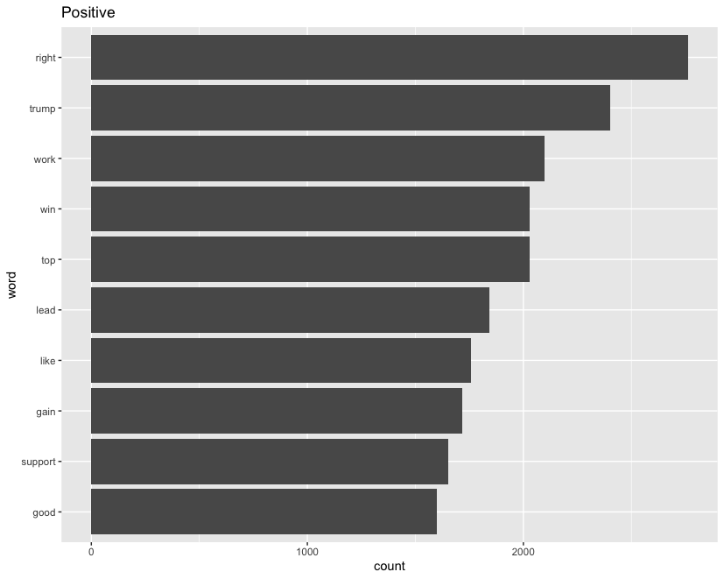
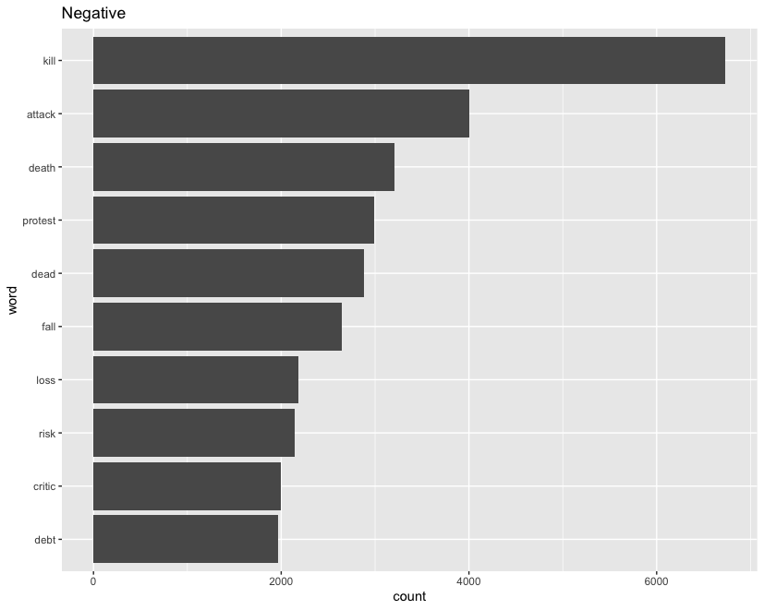
3.2 How Are News Related?
Positive
Negative

Slide 19
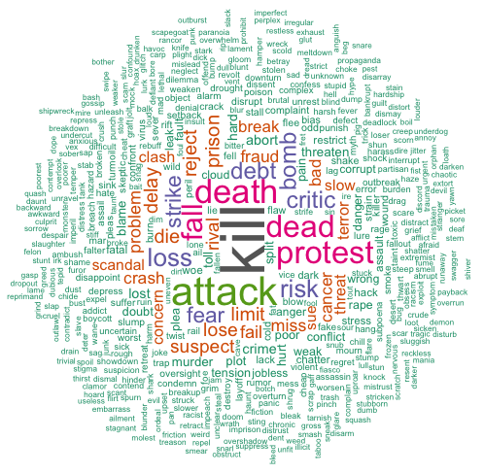
3.3 Not Clear Enough?
According to R bing sentiment lexicon
Kill, Attack, Death, Protest, Dead,
Fall, Loss, Risk, Critic, Debt
are top 10 words associated with negative sentiment

Slide 20
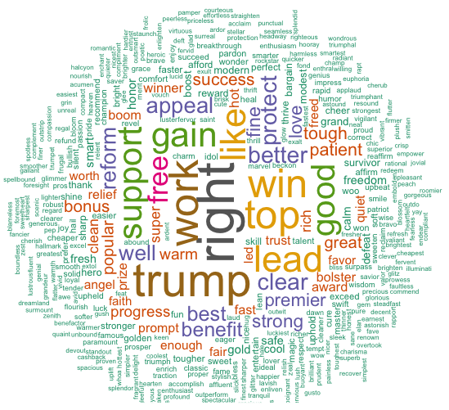
3.3 Not Clear Enough?
According to R bing sentiment lexicon
Right, Trump, Work, Win, Top, Lead,
Like, Gain, Support, Good
are top 10 words associated with positive sentiment

Slide 21
So far, the R sentiment analysis package is only used as supplementary.
But as a Statistics student, we must ask ourself how good or how bad does the sentiment score performs in the stock price prediction.

Slide 22
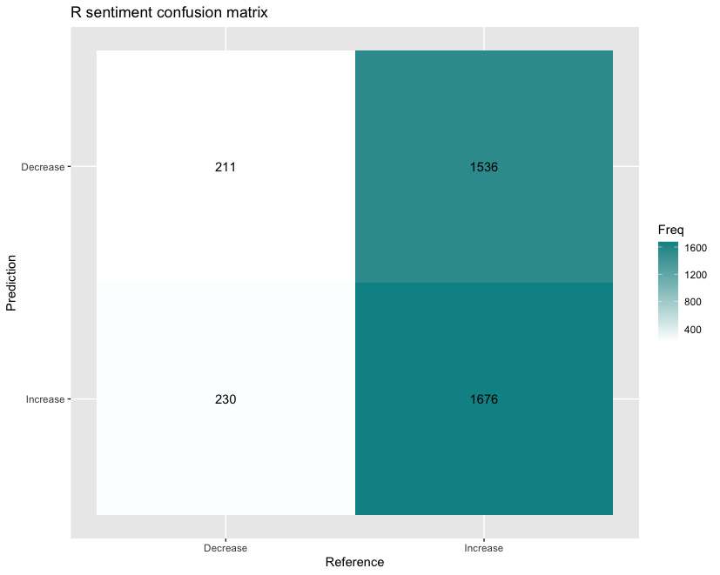
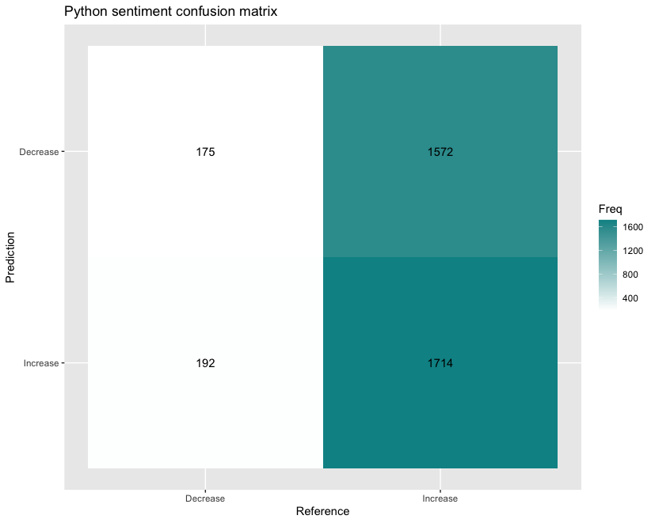
3.4 Confusion matrix
R (51.65%)
Python (51.71%)
R is more correct in False Negative (R: 211 vs Python: 175)
and less wrong in False Positive (R: 1536 vs Python: 1572)

Slide 23
3.5 Poor Performance, why?
Sentiment package in R and Python breaks down sentence into words
Question 1: In what way do you think the computer recognise double negative sentence?
“New medical instrument decrease death rate”
Question 2: Is every news related to the stock index or as important as headlines?
“Sunday’s Breakfast Menu” (NYTimes, 2007-09-15)
Sentiment score given to each word
Daily compounded score is generated based on the mean of individual score
Poor accuracy

Slide 24
3.6 Way to Improve
Sentiment could be useful but how much sentiment score’s involvement in prediction will be optimal?
We need an algorithm which include the back-propagation feature to repeatedly adjust the weighting of sentiment score in prediction: Long Short-Term Memory (LSTM)

Slide 25
LSTM
04

Slide 26

4.1 What is LSTM?
To illustrate with a metaphor:
We're standing on a beach, and some of the waves are small and some are big
How can we predict when the next big wave will hit the shore?
Stock Market – Ocean
Prices fluctuate constantly – Waves
Financial 'waves’ can be large and impactful or small and inconsequential

Slide 27

4.1 What is LSTM?
These fluctuations are influenced by an array of factors :
Economic indicators
Company performance
Global events
Market sentiment
Etc.

Slide 28
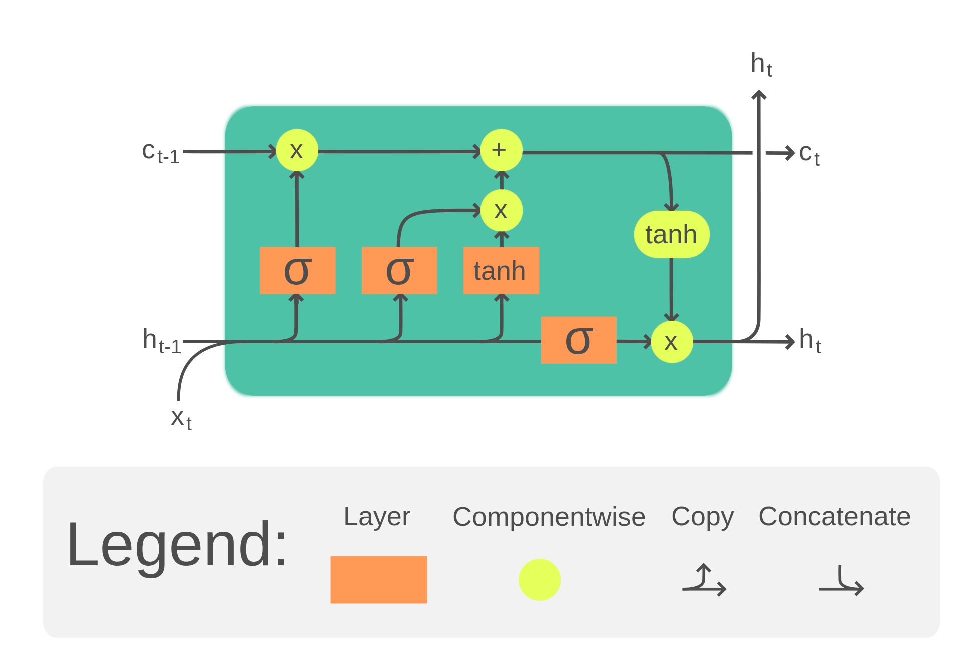
4.1 What is LSTM?
LSTMs: a type of AI specifically designed to understand and predict sequences of data
When applied to the stock market, they analyze the historical patterns of stock prices, learning from the sequence of ups and downs, much like studying the pattern of waves
They discern which patterns are likely to lead to significant changes ('large waves') and which are just part of the normal ebb and flow of the market

Slide 29

4.2 Why LSTM?
LSTMs are designed to remember information for long periods, which is crucial in understanding the context behind data sequences
This capability allows them to weigh the importance of different data points and decide which are likely to have a more substantial impact on future events

Slide 30

4.2 Why LSTM?
They can identify when the conditions are similar to those that have previously led to a significant rise or fall in stock prices, effectively predicting when the next 'big wave' of market movement is likely to occur
It's like having a seasoned guide by your side as you watch the waves, telling you when the next big one is coming so you can be ready to catch it

Slide 31
4.3 LSTM
Sentiment Score
Factor
Bias

Slide 32
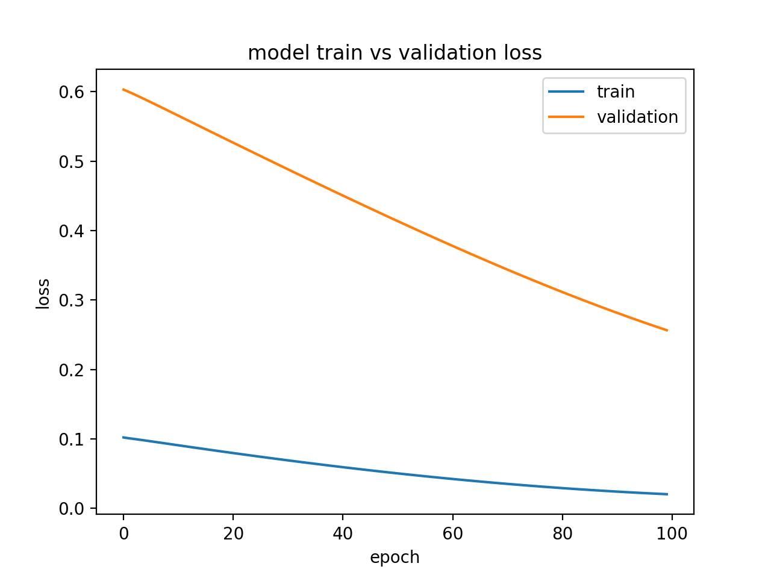
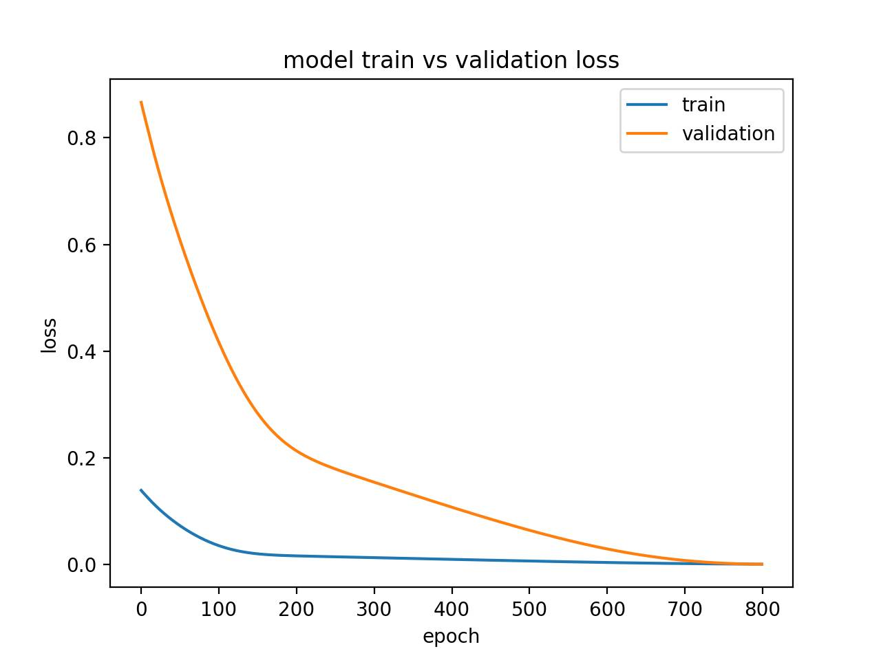
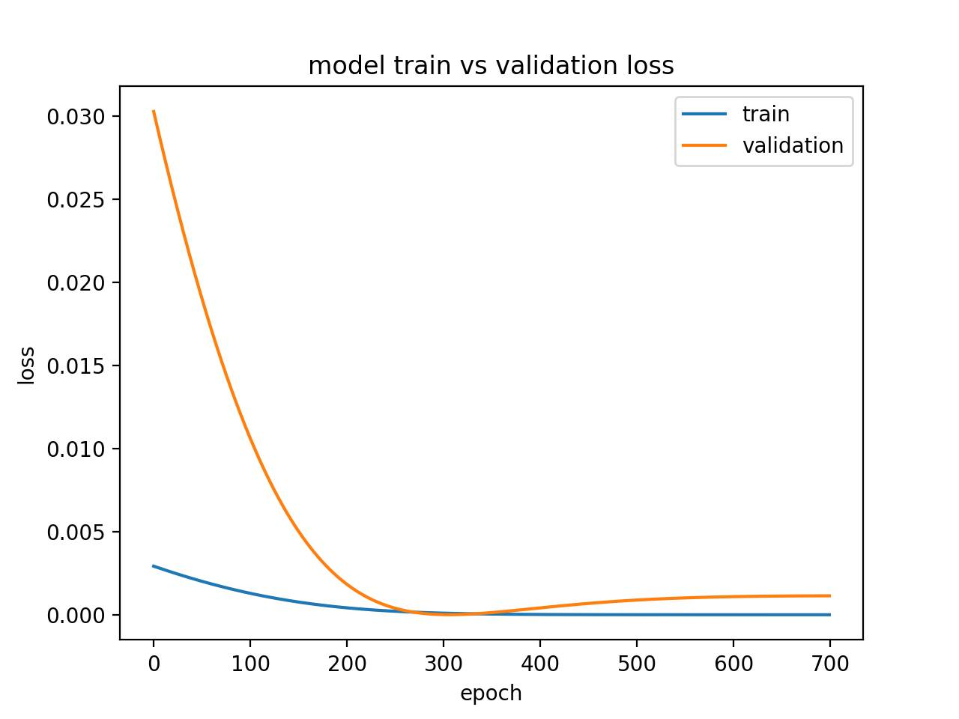
4.4 Model Train & Validation Loss
Under-fitting
Well-fitting
Over-fitting

Slide 33
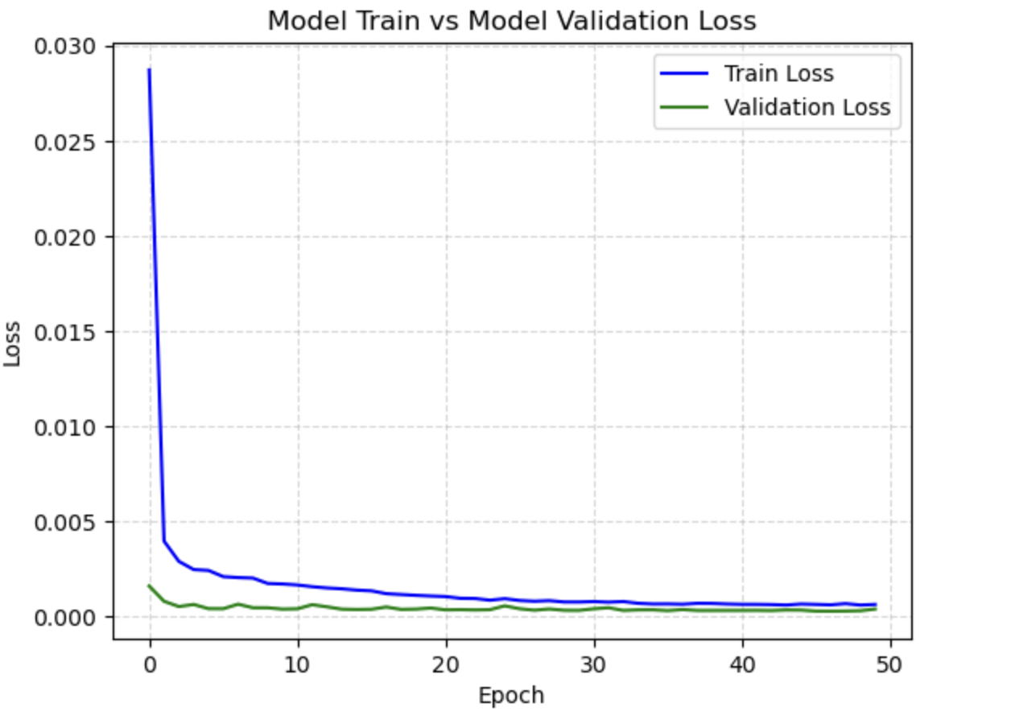
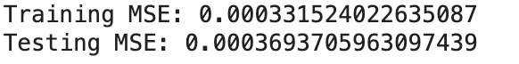
4.5 Factor: Sentiment Score
Acceptable but
not good enough

Slide 34
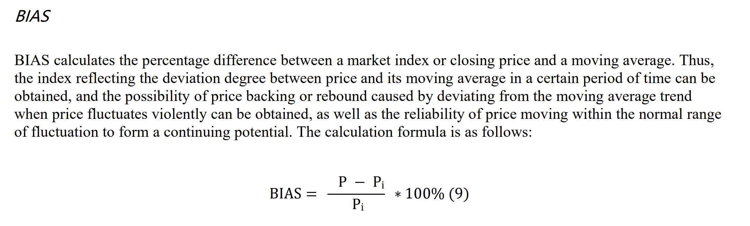
4.6 Introduction of Bias
BIAS as a measure index after news happened for a period of time to analyze the impact of news on stock price.
(Ren et al., 2020)

Slide 35
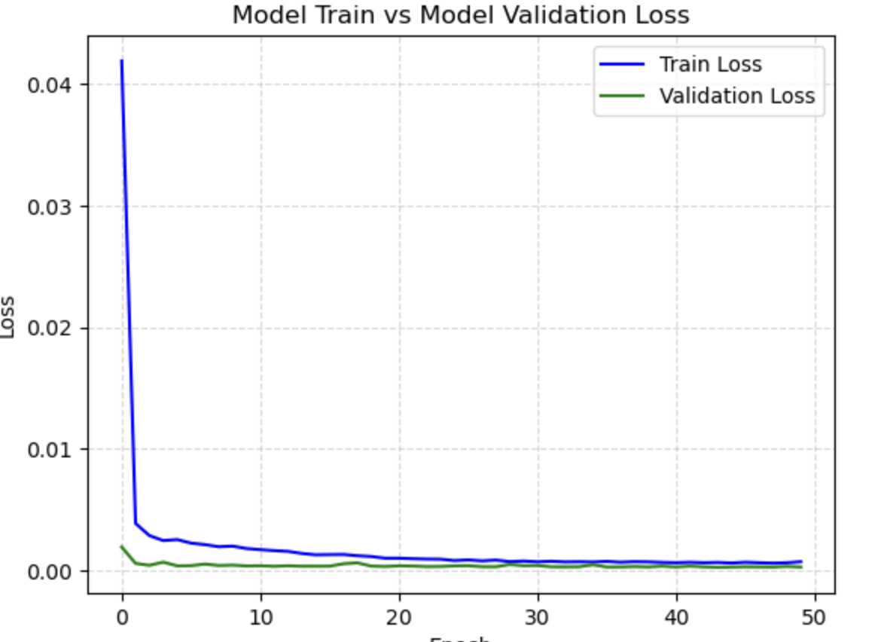
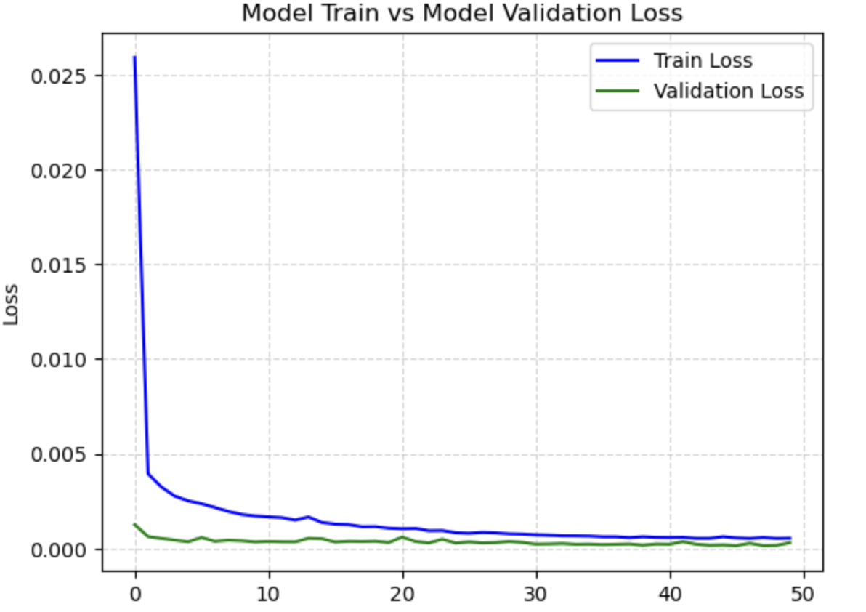
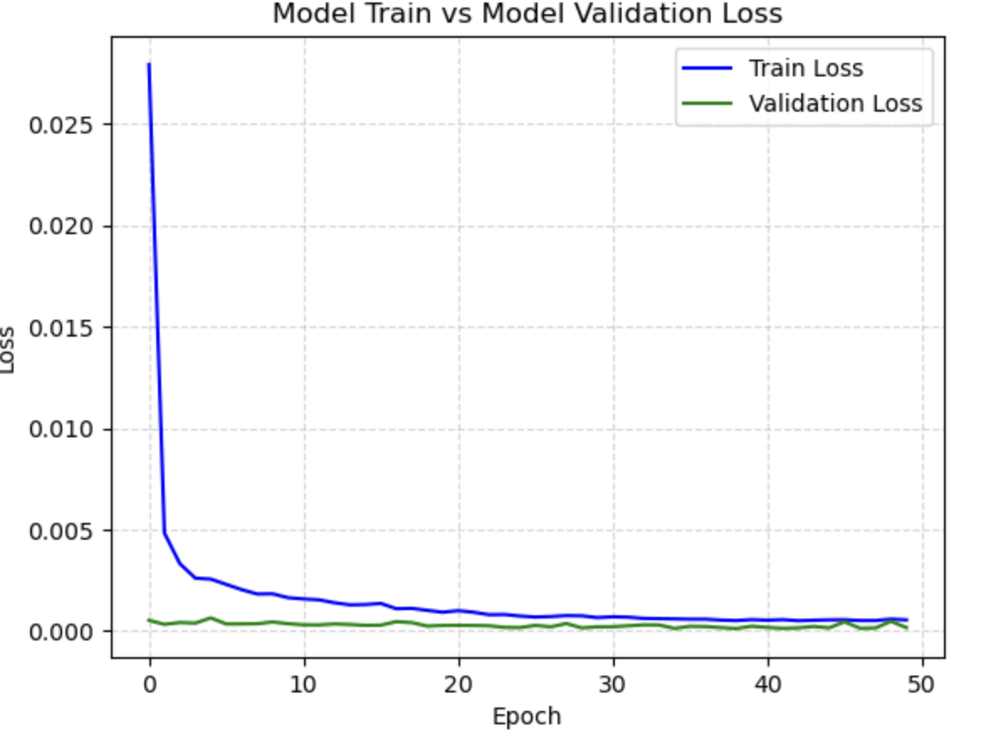
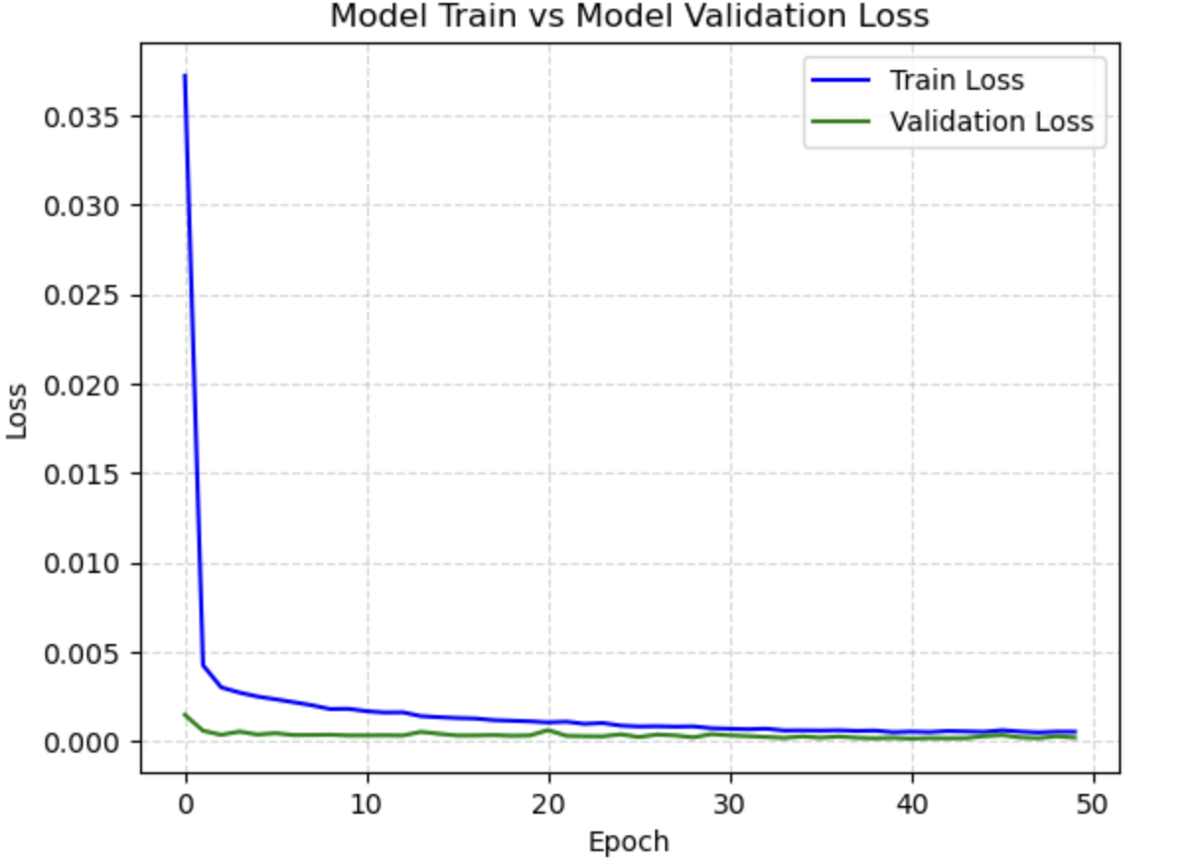
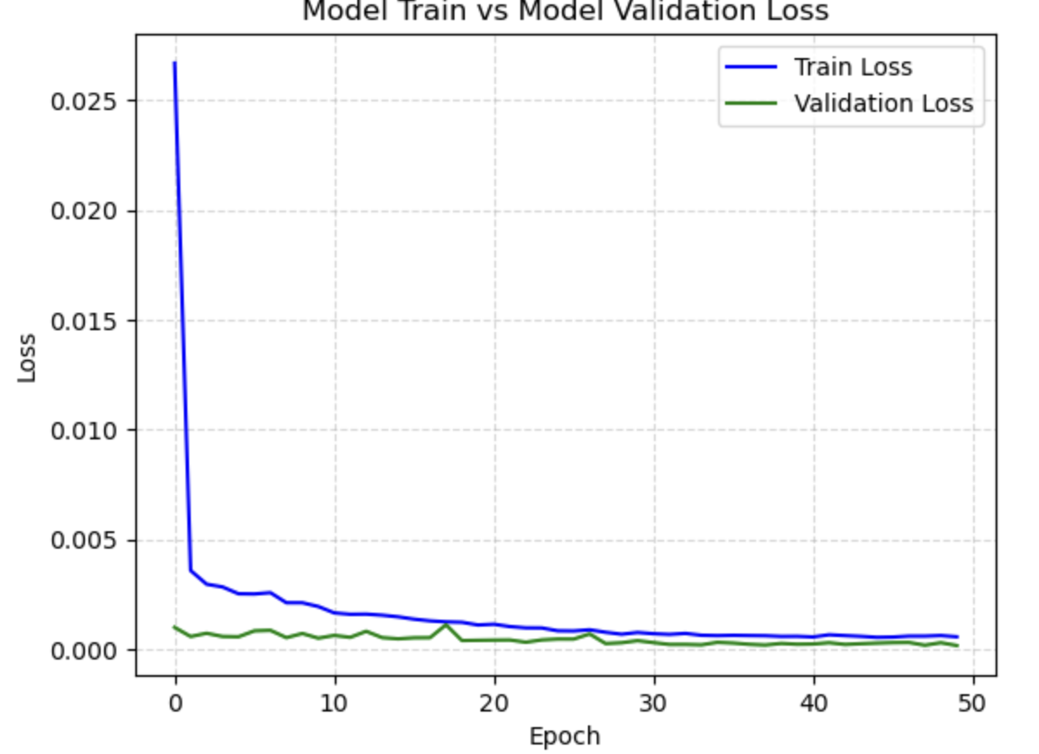
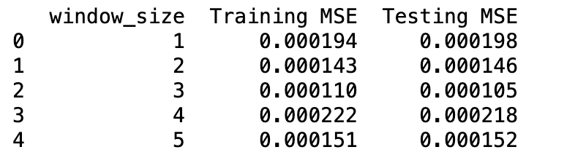
4.7 Factor: Sentiment Score & Bias
Window Size = 1
Window Size = 2
Window Size = 3
Window Size = 4
Window Size = 5

Slide 36
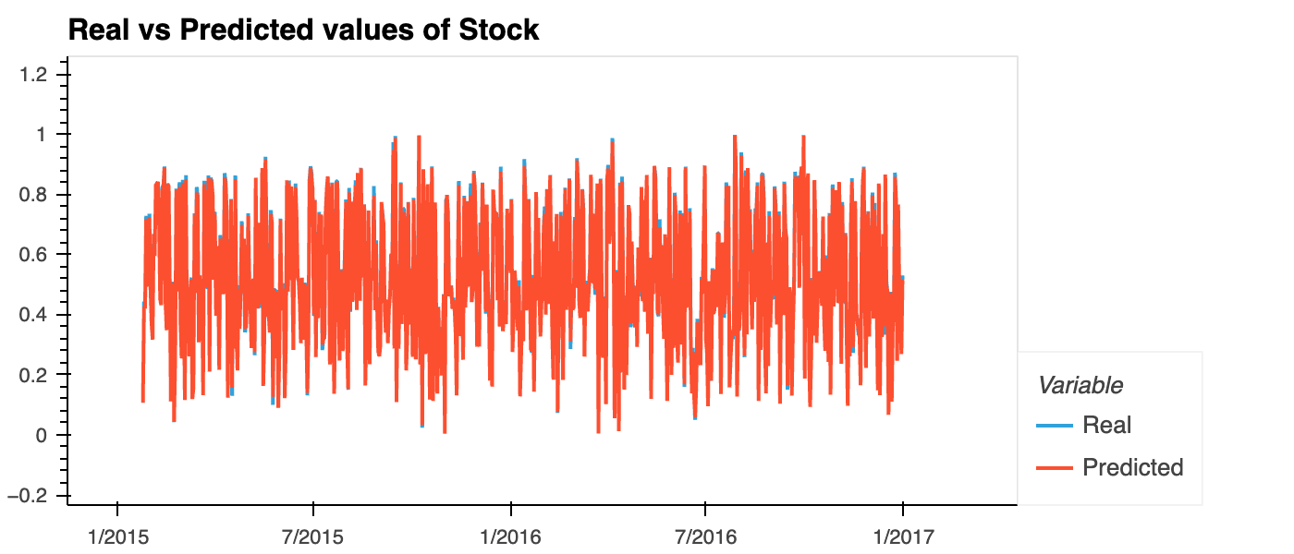
4.8 Result
Window Size = 2

Slide 37
Conclusion
Replication
Window Expansion
NLP
LSTM
MLP is the best method
Increase sample size reduce MSE
Sentiment analysis maybe misleading
Better approach

Slide 38
Thanks!
Do you have any questions?

Slide 39
Reference
Ren, Y., Liao, F. and Gong, Y. (2020) ‘Impact of news on the trend of stock price change: An analysis based on the deep bidirectiona LSTM model’, Procedia Computer Science, 174, pp. 128–140. doi:10.1016/j.procs.2020.06.068.
Thanaki, Jalaj. Machine Learning Solutions. 1st edition. Packt Publishing, 2018. Print.

Slide 40


